Slide 1
Human Factors and Safety Collaboration
Mike Goings
Lisa Chavez
BCI, Inc.

Slide 2
Presentation Outline
Difference Between Human Factors and Human Systems Integration
What is Human Factors?
Why Human Factors?
Human Factors Methods
How to Apply Human Factors
Safety and Human Factors
  Swiss Cheese Model
  Physical Human Factors Example
  Cognitive and Physical HF Example: Alerts
  Safety and Human Factors Collaboration

Slide 3
Difference Between Human Factors Engineering and Human Systems Integration
Human Factors ≠ Human Systems Integration
  Same with other HSI domains (e.g., safety ≠ HSI)
Human Systems Integration (HSI) is a management and technical (i.e., systems engineering) discipline that evaluates tradeoffs between the seven domains: Manpower, Personnel, and Training; Safety/Health; Human Factors, Habitability, and Survivability
Infographic developed by Dr. Sae Schatz

Slide 4

What is Human Factors?
Applying knowledge of human individual and team behavior, environment, and mental and physical characteristics for the design of systems, products, or services
Utilizes rigorous methods to analyze tasks, gather data, and prioritize actionable findings to help decision makers develop efficient and highly useable systems

Slide 5
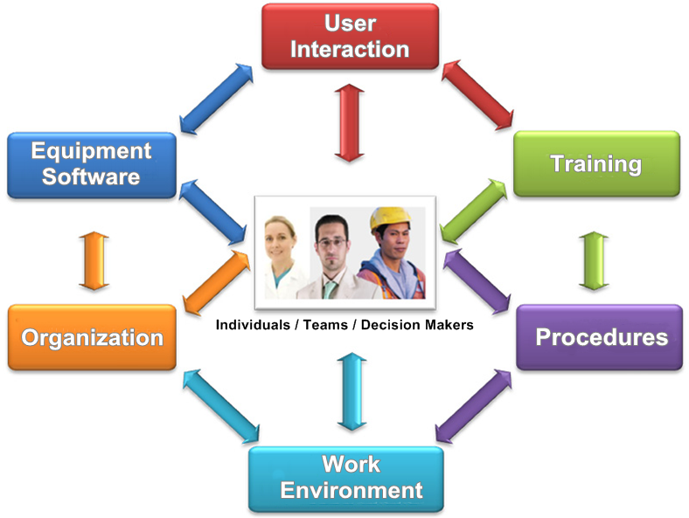
What is Human Factors? Whole System Focus
Based in part on a graphic from: http://www.alcoa.com/sustainability/en/info_page/safety.asp

Slide 6
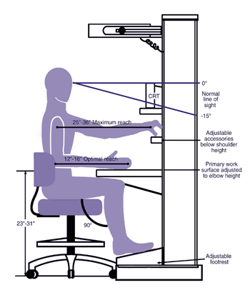

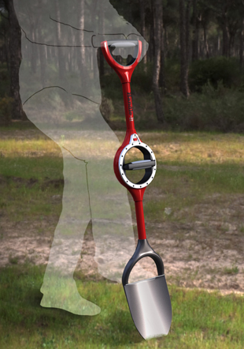
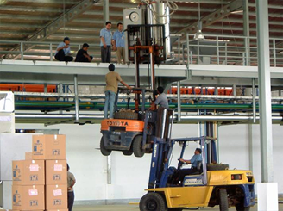

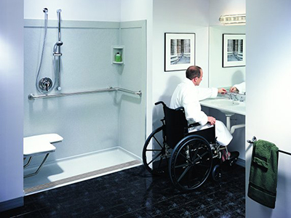
Why Human Factors?
Improving safety, procedures, training, and user interaction with equipment, tools, and products.

Slide 7
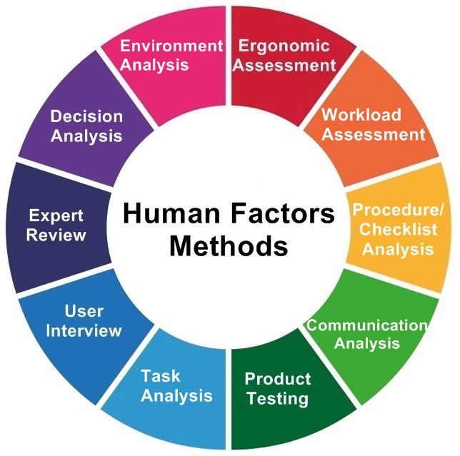
Based in part on a graphic from http://humanisticsystems.com/2014/09/27/systems-thinking-for-safety-ten-principles/

Slide 8




How to Apply Human Factors?
Refine, as necessary
Deliver Data-Driven Results
Execute appropriate method
Collect and Analyze Data
Evaluate Your Design, Product or Services
Select and tailor methods to problem
Understand constraints and decision maker needs and priorities
Reports prioritizing recommendations based needs & identifying improvements to:
  Implement now
  Implement later
  Implement when/if
  cost & feasibility permit

Slide 9
Safety and human factors

Slide 10
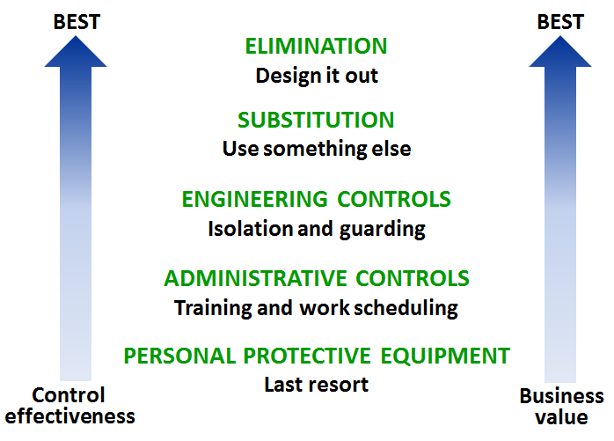
Hierarchy of Hazard Control

Slide 11
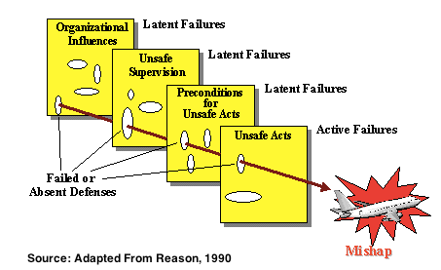
Swiss Cheese Model

Slide 12
Swiss Cheese Model
Active failures are acts of slips, lapses, fumbles, mistakes, and procedural violations committed by people in direct contact with system.
Latent conditions are issues that reside in a system and organization and create error conditions (e.g., time pressure, poorly designed interfaces, fatigue).

Slide 13
Physical Human factors example

Slide 14

Physical Human Factors
LCS 2 Decoy Loading
  Issue: The design of the decoy flare launcher did not take into account the warfighter’s task of loading the weapon system
  Redesign: Increase cost to the U.S. Navy

Slide 15
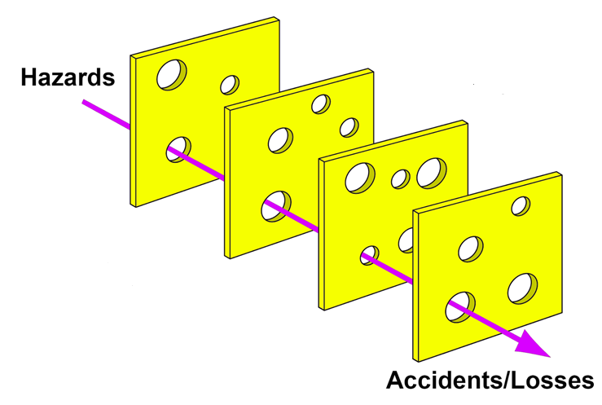
Physical Human Factors
Organizational: Not enforcing safe procedures
Environmental: Lack of proper means to secure personnel
Human: Working posture and muscular strain
Human error

Slide 16
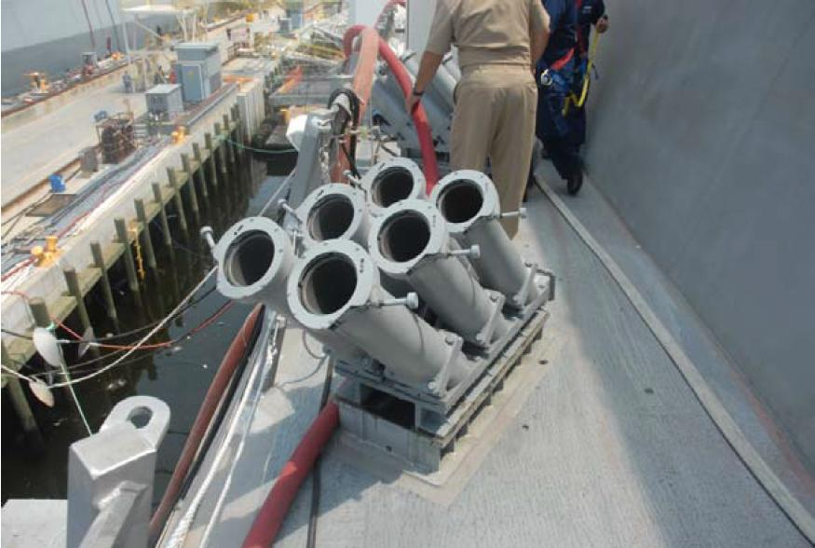
Physical Human Factors
LCS 2 Decoy Loading
  Define equipment
    Weight and length of flare
      65 lbs, 4ft long
    Position of flare chambers
  Define users’ tasks
  Define environment, constraints, and possible hazards
    Potential for muscular strain
    Potential for falling overboard
  Design equipment
  Develop procedures

Slide 17
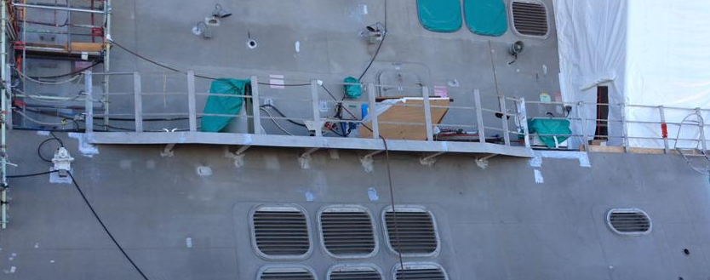
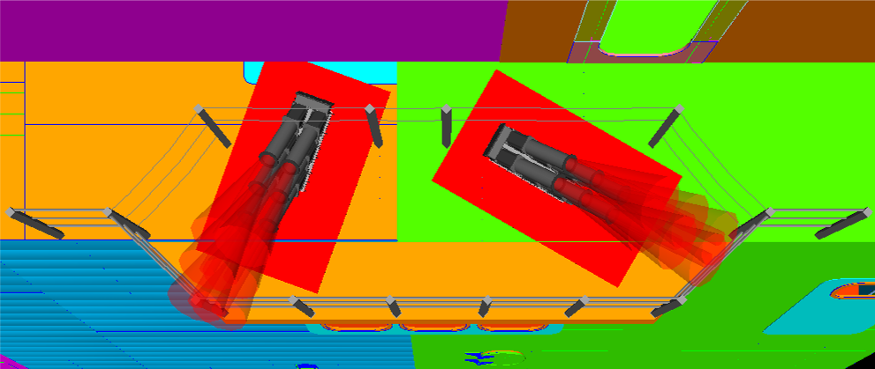
Physical Human Factors

Slide 18
Cognitive and Physical HF Example: Attention bar and Alerts

Slide 19
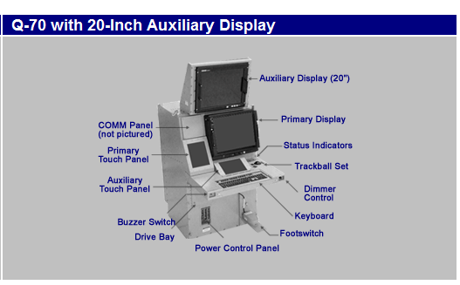
Primary Display

Slide 20
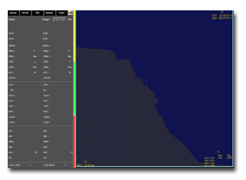
Three Part Attention Bar on Primary Display
The Attention Bar is displayed as a vertical strip between the TACSIT and Close Control Area.
Attention Bar provides "at-a-glance" indications and is divided into three segments
  Segment 1: Identification
  Segment 2: System Status
  Segment 3: Alerts
Red and flashing is used for high priority action alerts
Action alerts require the operator to review the text details in the alert review area on the lower part of the console.
  When the appropriate action is taken the red and flashing is removed.

Slide 21
Identification Attention Bar - Top Third
For operators executing identification tasks, the color of this attention bar indicates there are pending ID Conflict Alerts.
  Red - Indicates an ID Conflict Alert is in the queue regarding an upgrade or downgrade.
  Gray - Indicates no pending ID Conflict Alerts.
There are specific operators that perform majority of identification tasks.
Decision makers do some identification and serve as redundant checks on identification done by lower level operators.

Slide 22
System Status Attention Bar – Middle Third
The System Status is green if all equipment is operable.
The System Status flashes yellow or red for degradations or inoperable equipment status
Operators are cued by a flashing status bar.
The flashing indicator bar cues the operator to bring up the System Status window for detailed equipment information
Selected operators that are impacted by specific equipment problems.
The System Status bar shows gray for operators not affected by the specific equipment
Once the operator has viewed the applicable equipment status window, the Equipment Status bar stops flashing and turns gray.
Typically, lower level operators monitor equipment status with more frequency than decision makers.

Slide 23
Alert Status Attention Bar –Bottom Third
Depending on whether or not the operator is a decision maker or lower level operator – alerts are tailored to that role.
  Red (blinking) - Pending alert with priority 1 or 2.
  Red (steady) – Pending alert with priority 3.
  Yellow (steady) – No high priority alerts, but there are pending medium alerts with priority 4, 5, or 6.
  Gray – No pending alerts with medium or high priority, but there are pending alerts with priority 7 or 8.

Slide 24
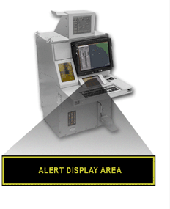
Reviewing Alert Details

Slide 25
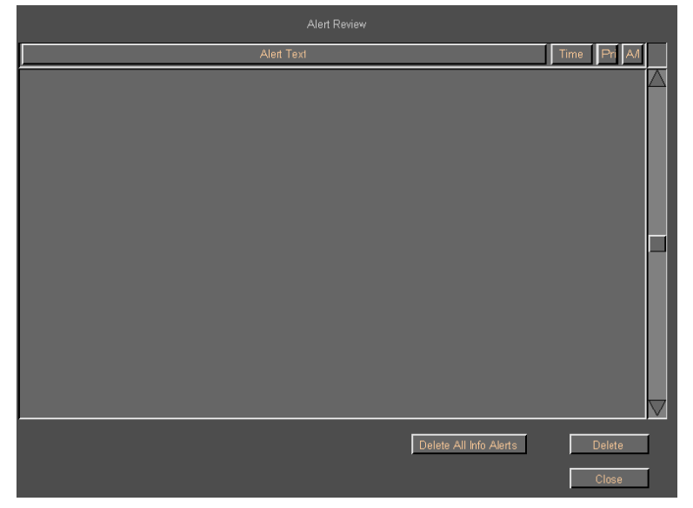
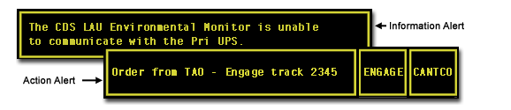
Alert Display Area

Slide 26
Complexity, Color Coding & Space Allocation
Single alert bar design chosen to accommodate different operator roles: decision makers and lower level operators
  Maximizes space for tactical map and close control readout for track information
  Loss of diagnostic information on the primary screen
Experienced operators report :
  “Ignoring” red color coding and flashing due to frequency
  For high priority action alerts, text is read on a separate window to understand the action to perform to dismiss the alert (stop flashing and red on the attention bar)
  Yellow color coding for medium alerts applies for moderate level of importance – yellow and blinking isn’t meaningful and intuitive
    Information alerts (coded yellow and that may be flashing) will need to be read on the larger alert review area and then prioritized based on operator role and current task load/context

Slide 27
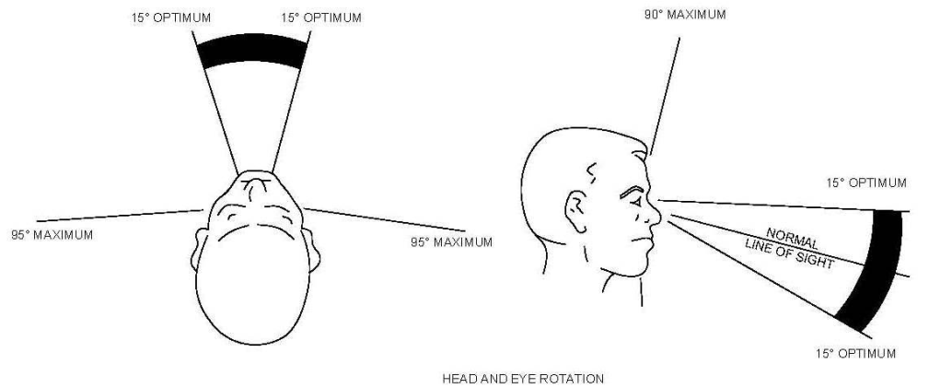
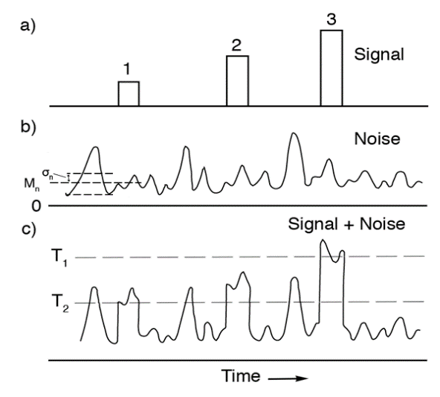
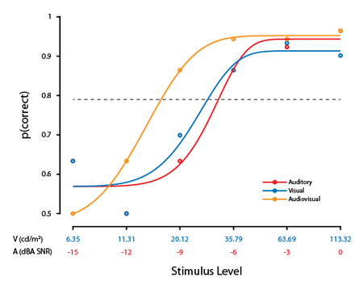
Alert Design Considerations
Hierarchy of importance
  Salience
Operators’ tasks
  Information channel and conflict
Field of view
Environment
  Auditory detectability
    Tone vs. Speech
  Visual salience
Number of alerts
  Tone and pulse
Location of alerts

Slide 28
Safety and HUMAN Factors Collaboration

Slide 29
Rationale for Collaboration
Many issues are both human factors and safety related
  Making tradeoffs that benefit the user requires analysis from both domains
Safety and HF practitioners have different viewpoints but shared goal of safe and effective operation
For HF practitioners analysis that a human factors issues to safety hazard results in:
  Elevated risk assessment
  Increased the likelihood that safety concerns are designed out to begin with, or
  Increased likelihood that issue will be fixed in a future build

Slide 30
Collaboration Strategies
Safety and Human Factors Engineers SHOULD work together on design solutions and the evaluation of risk
Recognize that the human is an integral part of the system and has inherent physical and cognitive capabilities and limitations
    Physical considerations include
      Anthropometry
      Impact of clothing, Personal Protective Equipment (PPE), and gear (e.g., backpack)
      Impact of environment (lighting, temperature, noise, vibration)
      Body posture and movement
      Vision (use of color, distance of information, font type, screen resolution)
    Cognitive considerations include
      Presentation of information (information grouping and categorization)
      Memory limitations
      Distractions
      Environmental impact on cognition

Slide 31
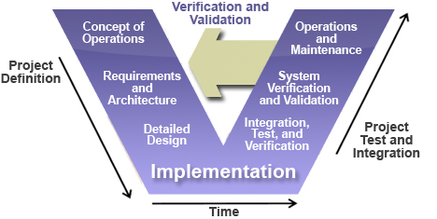
Collaboration Strategies by System Engineering Phases
Early Middle Late

Slide 32
Collaboration Strategies by Phases
SE Phase | HFE Activities | Safety Activities | Collaboration Activities
Concept of Operations | Analyze tasks, environment, and operational constraints Define representative users | Identify potential hazards | Define scenarios that may lead to hazardous conditions
Requirements and Architecture | Develop requirements to accommodate human capabilities Evaluate requirements with safety impact | Develop requirements to mitigate hazards Review requirements that specify operator tasks or imply human performance | Specify requirements that lower hazard risk index Advocate for rigorous verification method for safety and human factors requirements

Slide 33
Collaboration Strategies by Phases
SE Phase | HFE Activities | Safety Activities | Collaboration
Detailed Design | Develop and iterate prototypes Measure workload and task performance using prototypes | Provide cautions, warning and labels Review designs Document new hazards | Analyze design trade offs Identify procedures for safe operation
Integration, Test, and Verification | Verify human related requirements during subsystem testing | Verify safety-related requirements during subsystem testing | Collaborate in identifying events with both safety and human implications Share findings/results from events

Slide 34
Collaboration Strategies by Phases
SE Phase | HFE Activities | Safety Activities | Collaboration
System Verification and Validation | Verify and validate human related requirements during system integration testing Identify workload impact on mission performance | Identify mission-level risks | Trace the implications of high workload conditions that increase likelihood of safety risk Recommend design fixes that reduce risk Promulgate limitations and workarounds
Operations and Maintenance | Assess operations Analyze mishap reports Collect lesson learned | Document unsafe practices Develop safety bulletins and training Safety mishap investigation | Identify design changes and enhancements

Slide 35
Special Thanks
Special thanks to the DC Chapter of the Int. System Safety Society for this opportunity.
Special thanks to John Murgatroyd and Jason Green for providing examples and your time.
Special thanks to Eric Stohr, John Winters, and Fred Germond for your valuable input.

Slide 36
References
Hierarchy of Hazard Controls". NYCOSH. Retrieved 2012-04-11.
  http://nycosh.org/wp-content/uploads/2014/10/hierarchy-of-controls-Bway-letterhead.pdf
Reason J. Human error. New York: Cambridge University Press; 1990.

